Slide 1


ASHK DO CHAAR
By Iftikhar Ahmed Qureshi (Jaazib)

Slide 2
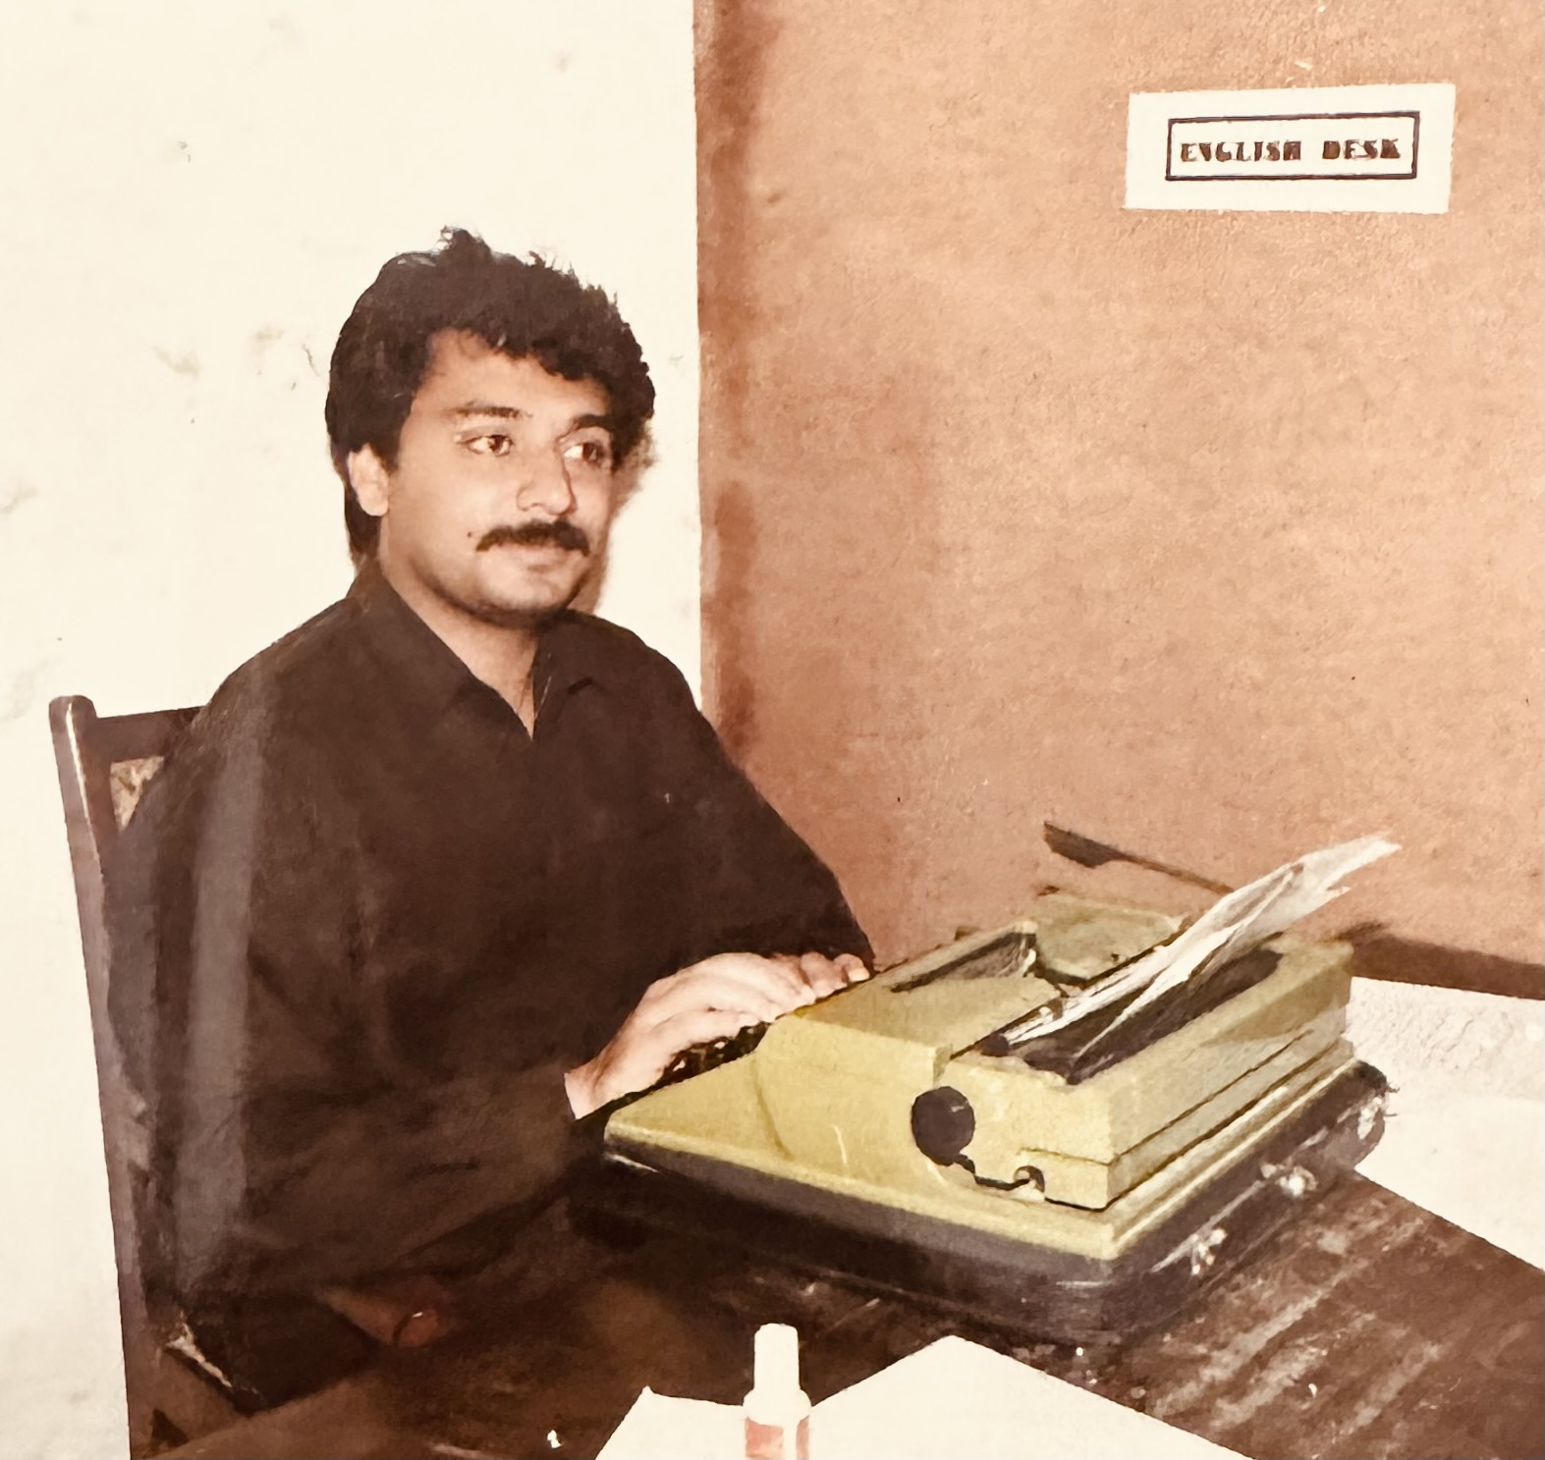
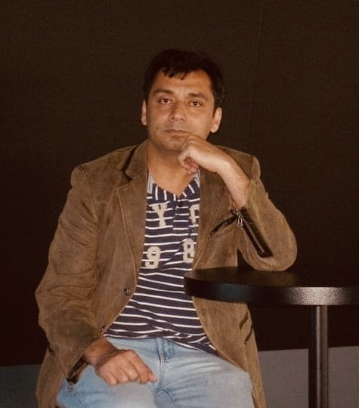
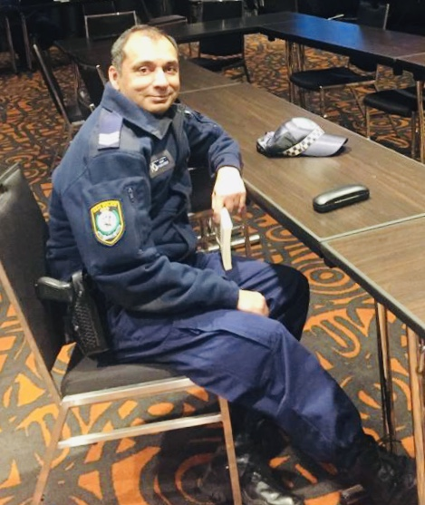
Iftikhar Ahmed Qureshi
JOURNALIST
Author
Police Officer

Slide 3
FEW NEWS ITEMS BY IFTIKHAR
IN PAKISTANI ENGLISH NWSPAPERS
DAWN, NATION & THE NEWS

Slide 4
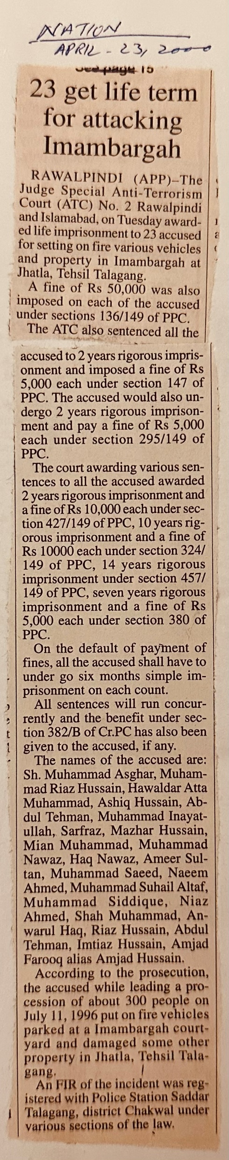
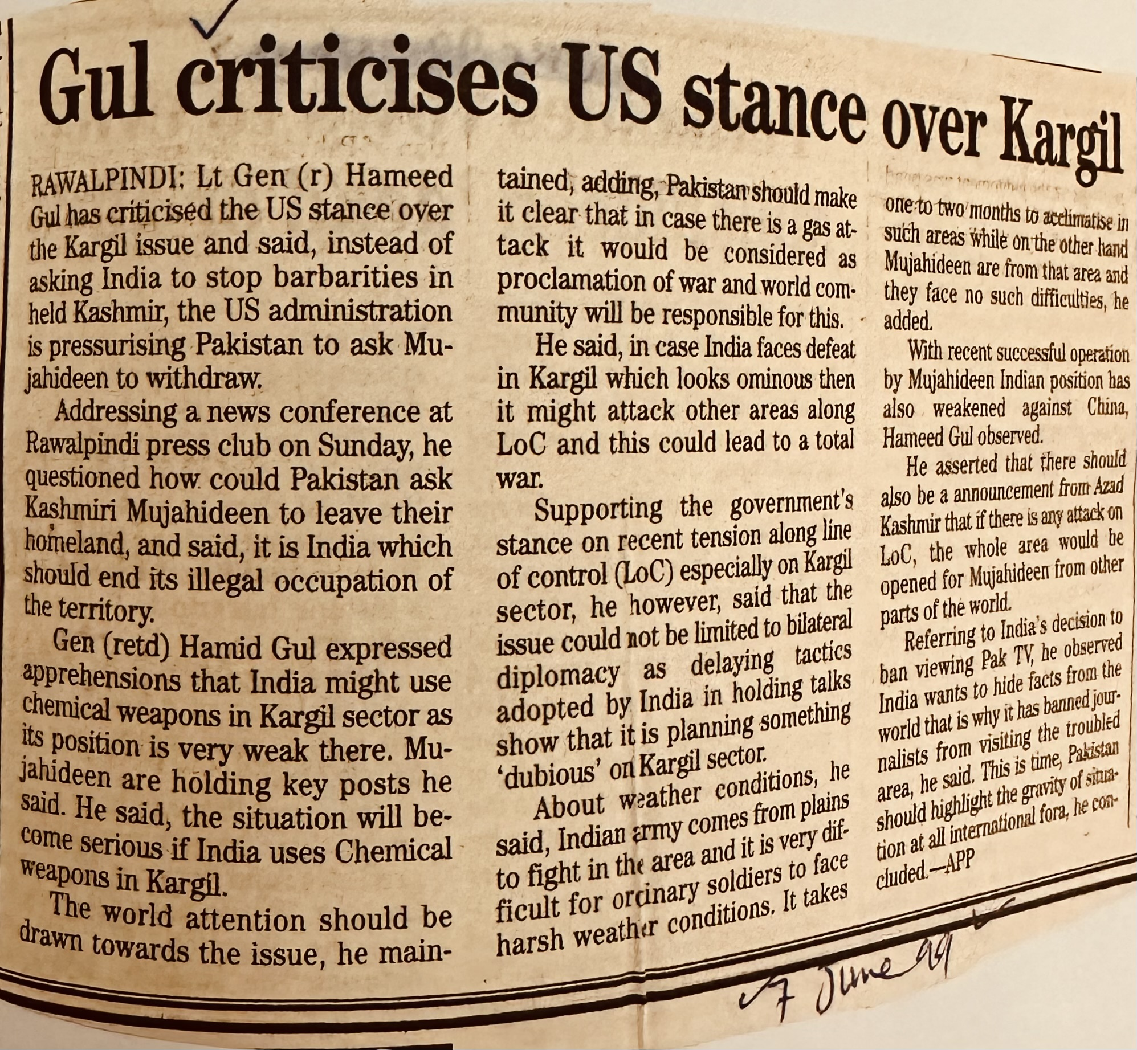
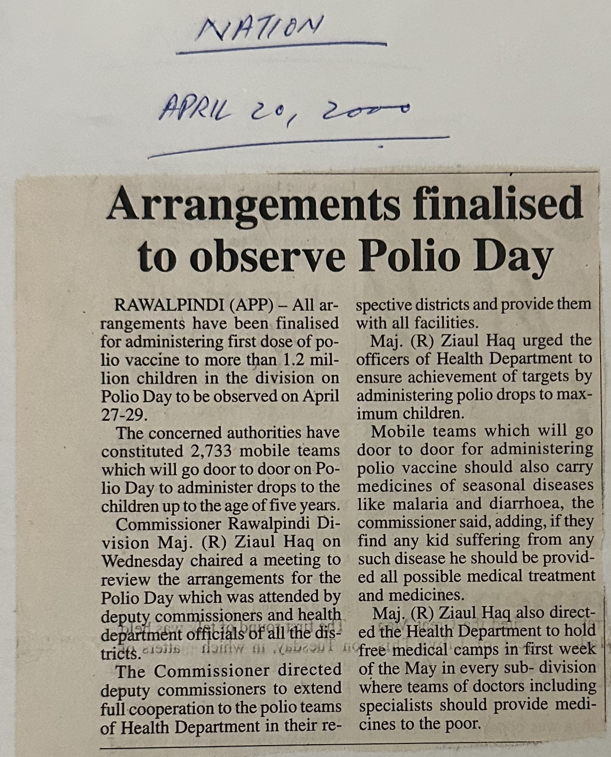
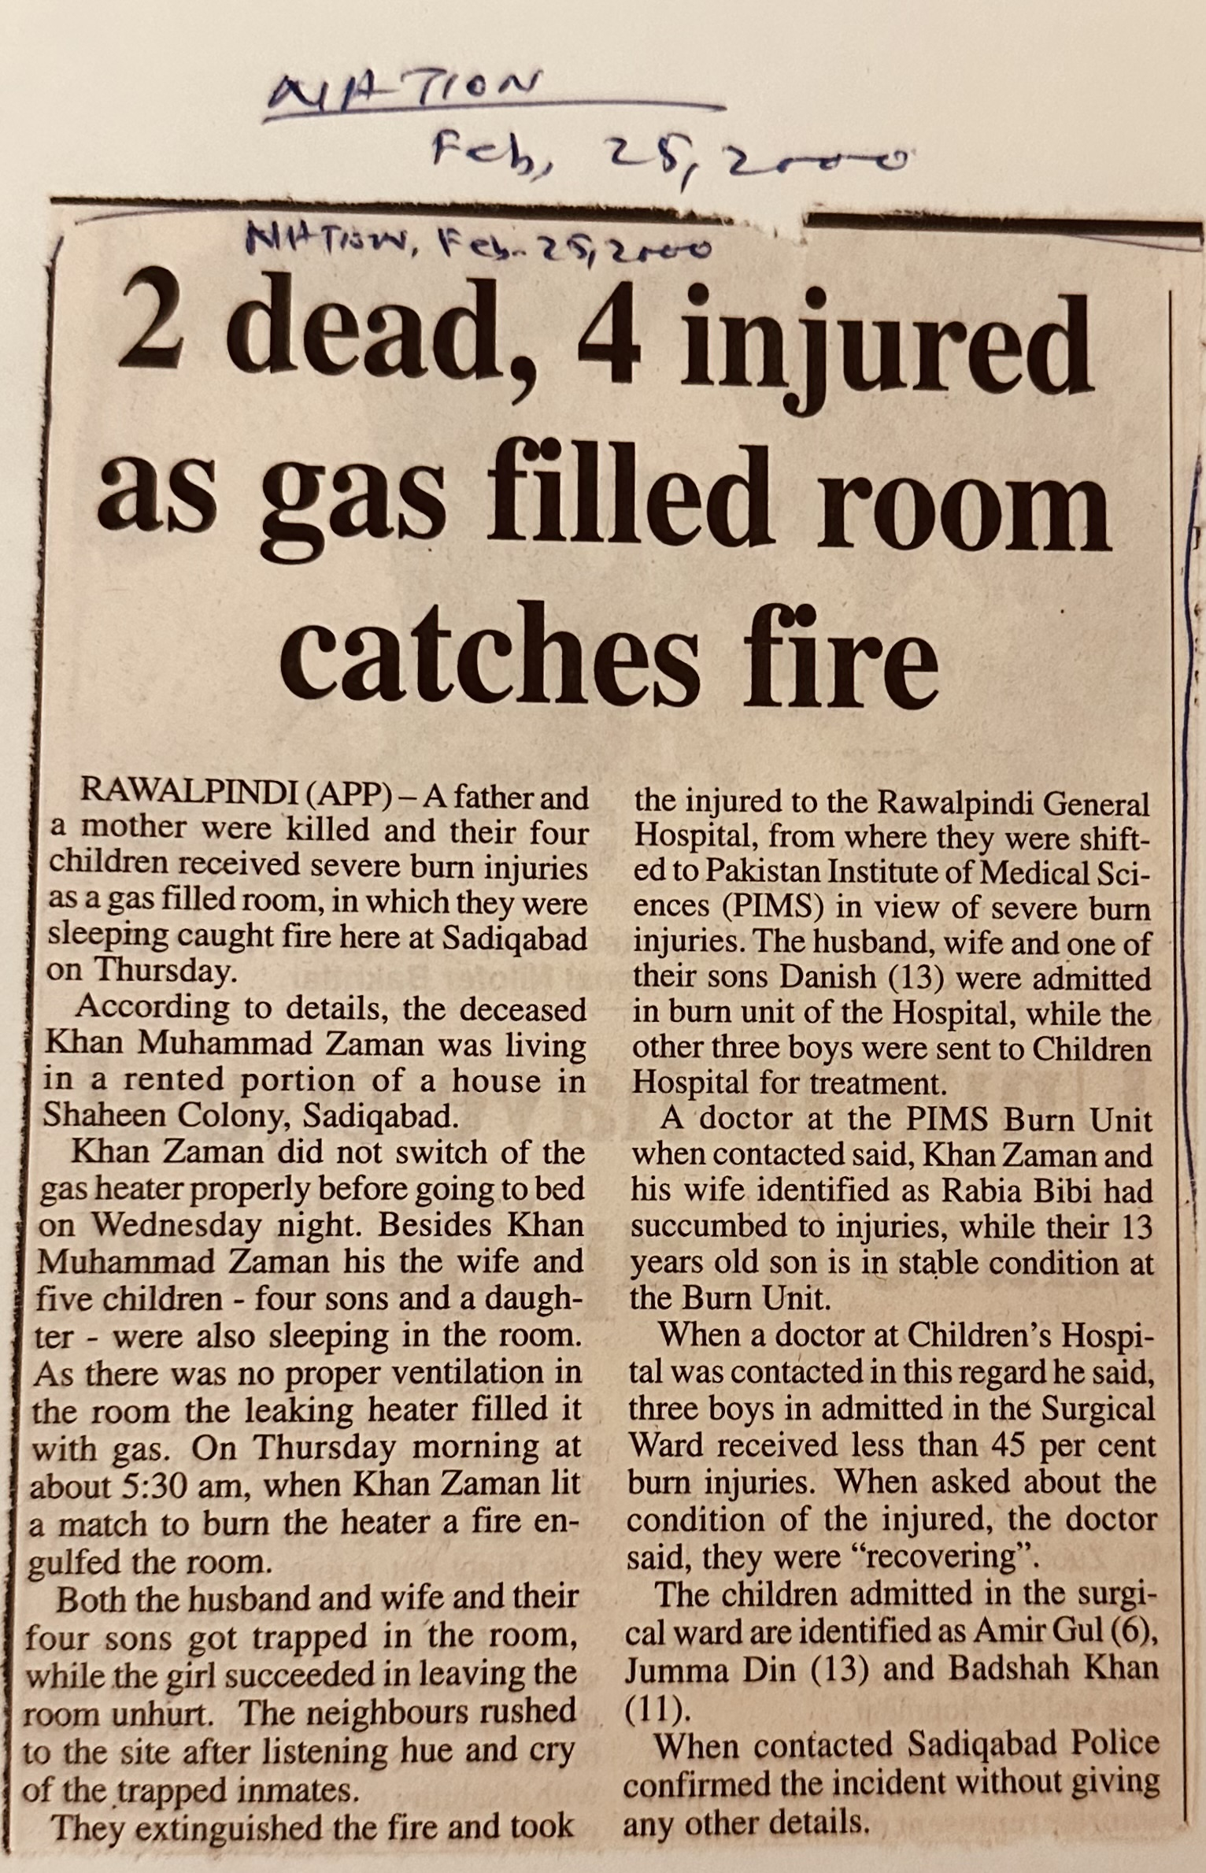
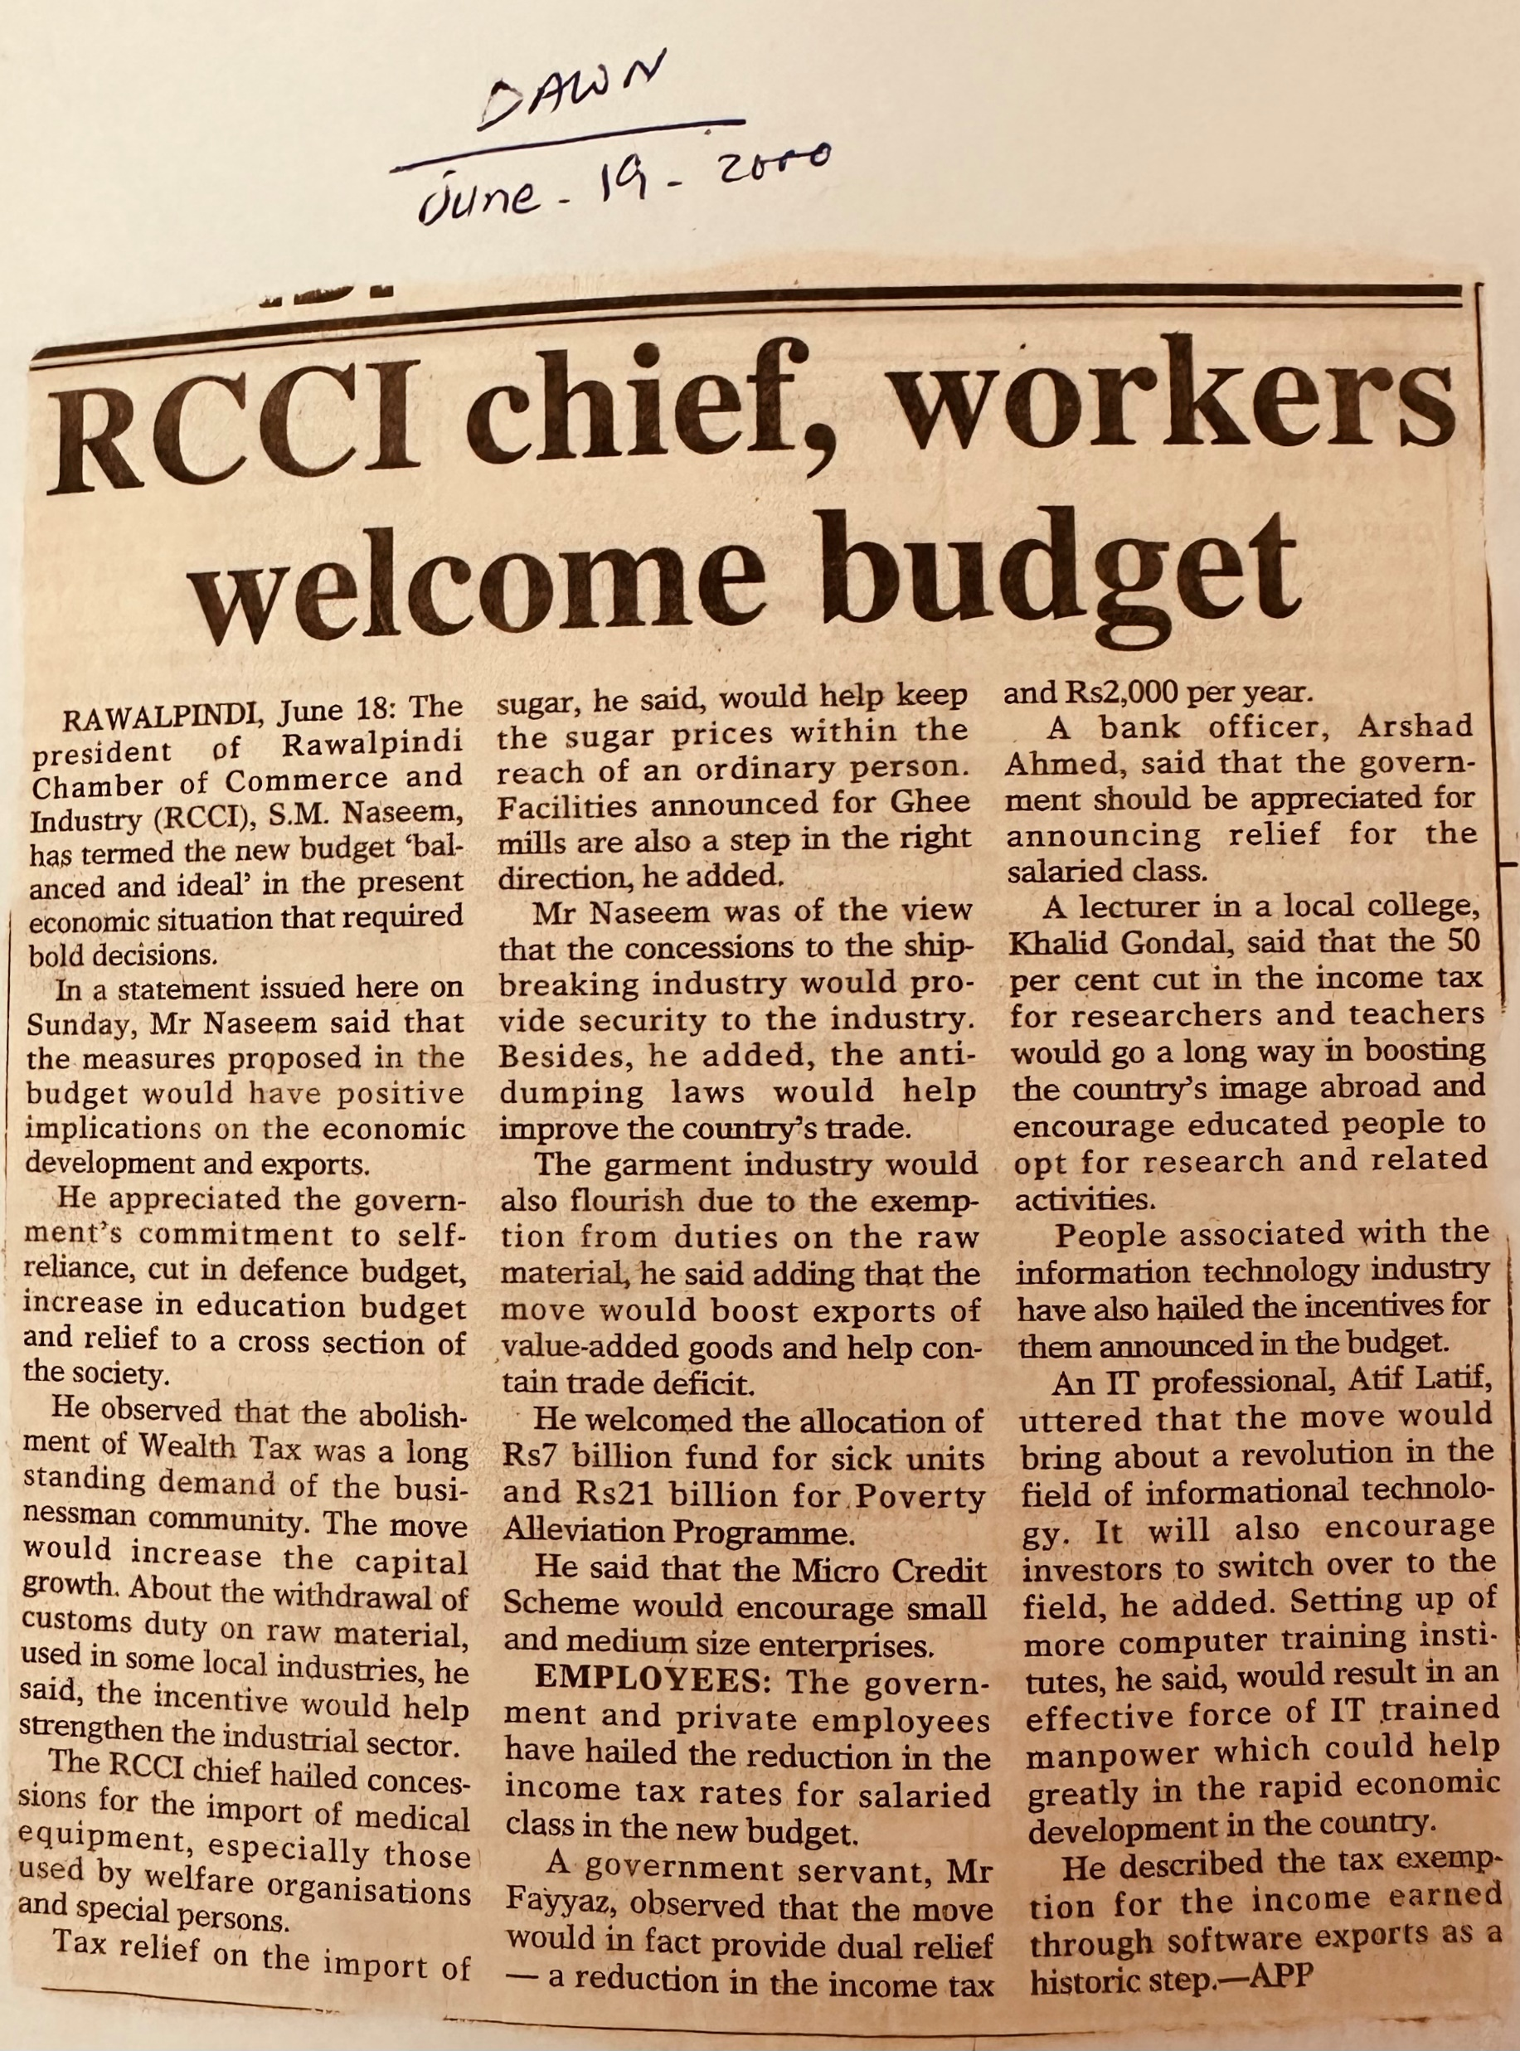

Slide 5


Slide 6
Introduction of Author
Biography of the Author
My country of birth is Pakistan and I worked there as a journalist for a wire service – Associated Press of Pakistan (APP). I arrived in Sydney in late 2000 with my family. After working casual jobs for seven years I found a permanent employment with NSW Police Force and is still working with them. I have post graduate degrees in International Studies from the University of Sydney and English Literature and Mass Communication from Pakistan.

Slide 7
Articles in Urdu Blog: HUM SUB
About my Novel
My intended audience are the readers who are interested in exploring individual freedom within the existing societal and religious systems.

Slide 8
Service memorial
01
plaque on the Memorial
02
POLICE OFFICER
04
03

